Slide 1
Semantic image segmentation
Oleksandr Kushnir
R&D Engineer

Slide 2
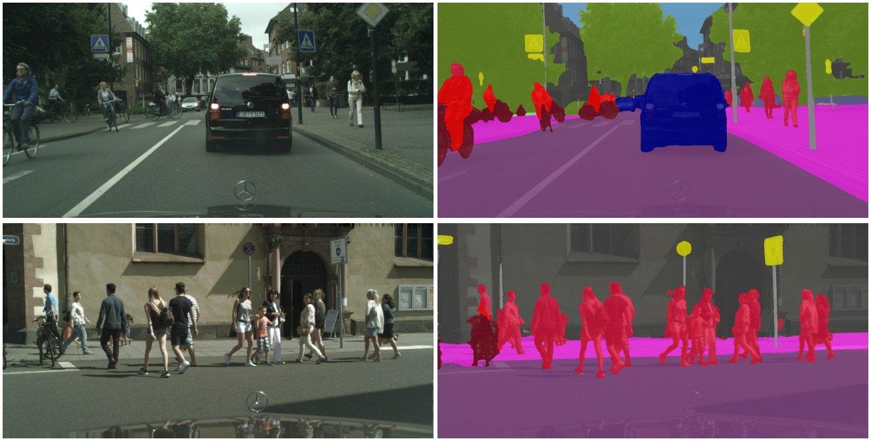
Introduction
Semantic segmentation refers to the process of linking every pixel in an image to one or several class labels from a defined set.
Processing
Input
Result

Slide 3
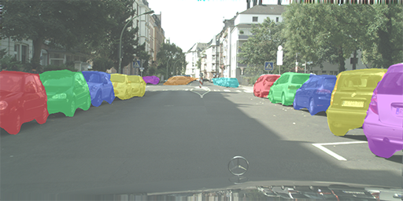
Introduction
Instance segmentation is one step ahead of semantic segmentation. In addition to the classifying each pixel, it is necessary to recognize each instance of a class.

Slide 4
Semantic Segmentation Applications
Facial Segmentation;
Robotics;
Fashion Categorization;
Bio-medical Image Diagnosis;
Autonomous Driving;
Satellite Image Processing;
Precision Agriculture;
Geosensing / Land Usage Analysis.

Slide 5
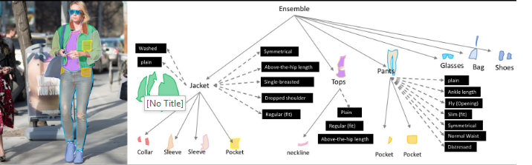
Fashion Categorization

Slide 6
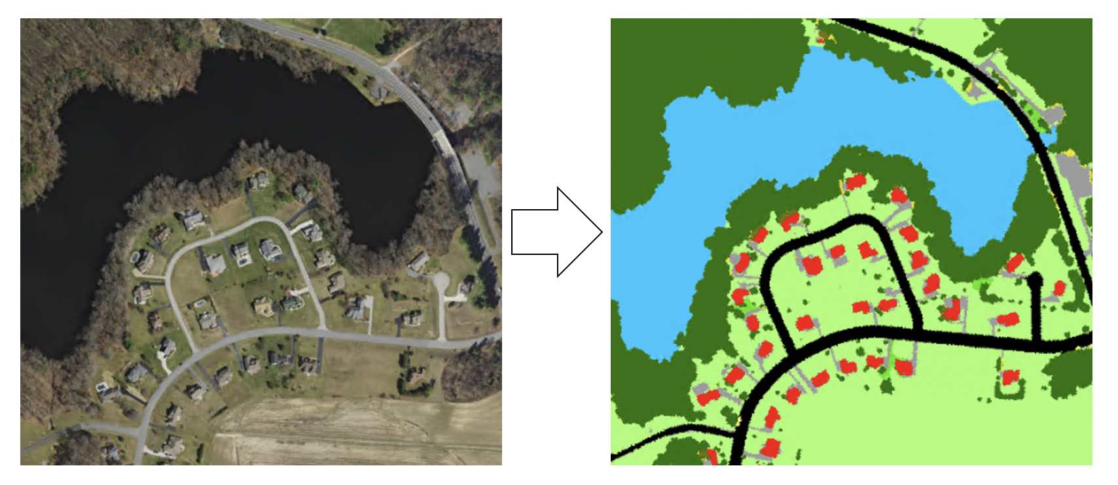
Aerial Image Segmentation

Slide 7
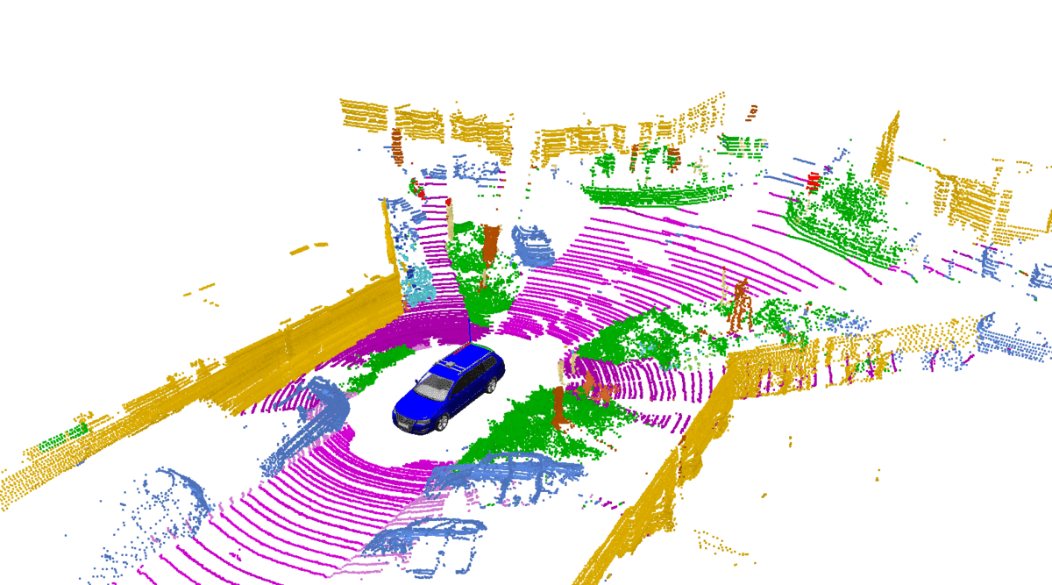
Autonomous Driving

Slide 8
Neural Network
Input
Output
Output
layer
Input
layer
Hidden layers

Slide 9
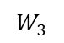
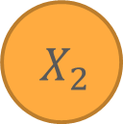
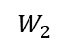

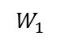
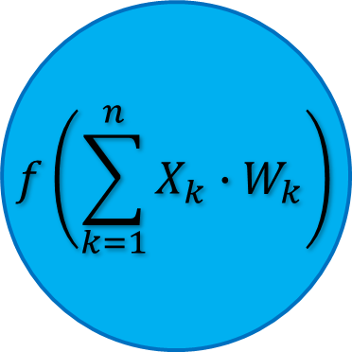
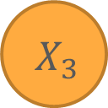
Neural Network
$$X_{1}$$
$$f\left(\sum_{k=1}^{n}{X_{k}∙W_{k}}\right)$$
$$W_{1}$$
$$X_{2}$$
$$W_{2}$$
$$W_{3}$$
$$X_{3}$$

Slide 10
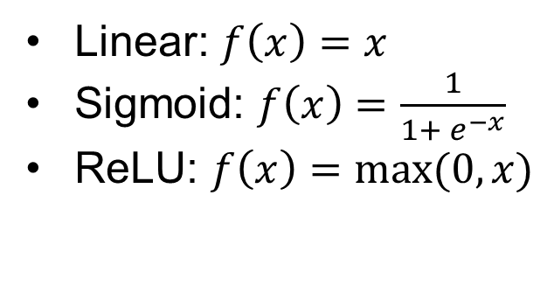
Neural Network
Linear: $f\left(x\right)=x$
Sigmoid: $f\left(x\right)=\frac{1}{1+ e^{−x}}$
ReLU: $f\left(x\right)=max⁡(0, x)$

Slide 11
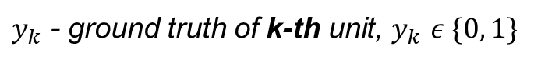
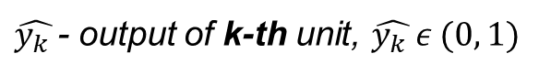
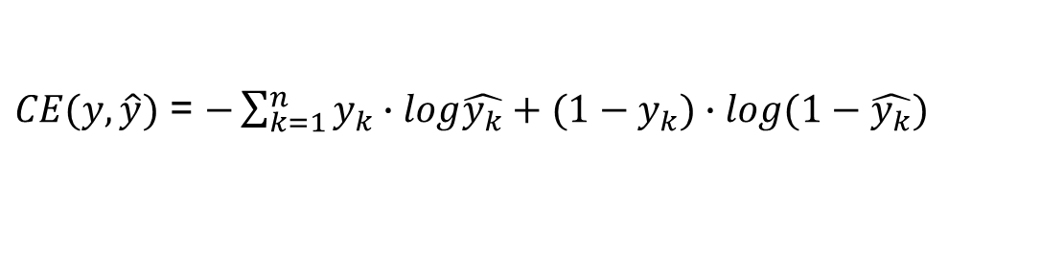
Neural Network
Loss function: Cross-entropy loss
$\hat{y_{k} }$- output of k-th unit, $\hat{y_{k} }ε (0, 1)$
$y_{k}$ - ground truth of k-th unit, $y_{k}$ $ε \{0, 1\}$
$CE(y, \hat{y})$ = $−\sum_{k=1}^{n}{y_{k}∙log\hat{y_{k}}+{(1−y}_{k})∙log(1−\hat{y_{k}})}$

Slide 12
Neural Network
Forward
path

Slide 13
Neural Network
Forward
path
Loss

Slide 14
Neural Network
Forward
path
Loss
Backward
path

Slide 15

Convolutional Neural Network

Slide 16

Convolutional Neural Network
Convolution

Slide 17
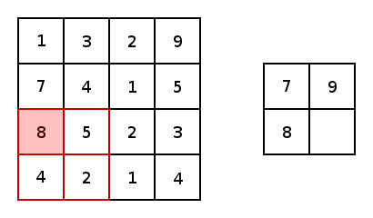
Convolutional Neural Network
Pooling

Slide 18
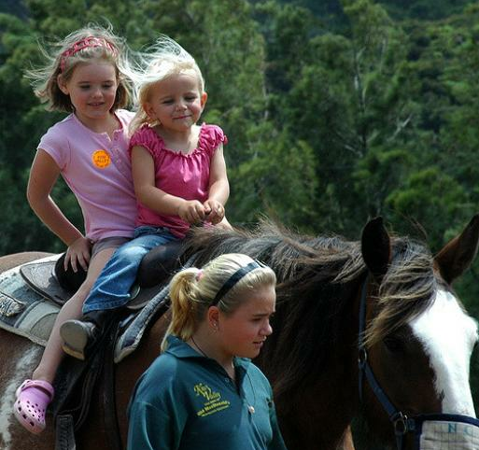
Basic Approach
Input

Slide 19
Basic Approach
Extract patches one by one
Input

Slide 20
Basic Approach
CNN
Person
Horse
Background
Extract patches one by one
Classify central pixel
Input

Slide 21
Basic Approach
CNN
Person
Horse
Background
Extract patches one by one
Classify central pixel
Post-processing
Optional part
Input

Slide 22

Basic Approach
CNN
Person
Horse
Background
Extract patches one by one
Classify central pixel
Post-processing
Optional part
Input
Result

Slide 23
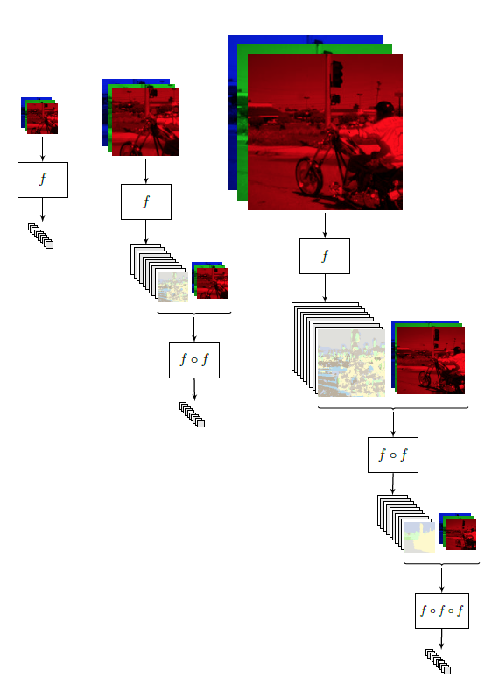

Recurrent Convolutional Neural Network

Slide 24
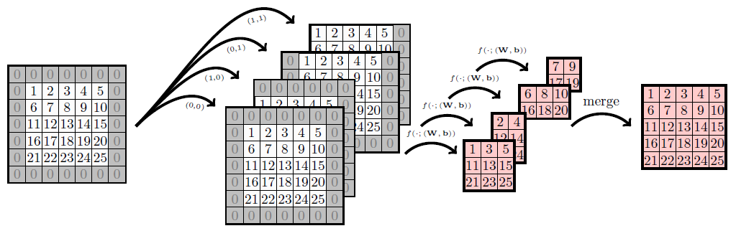
Recurrent Convolutional Neural Network

Slide 25
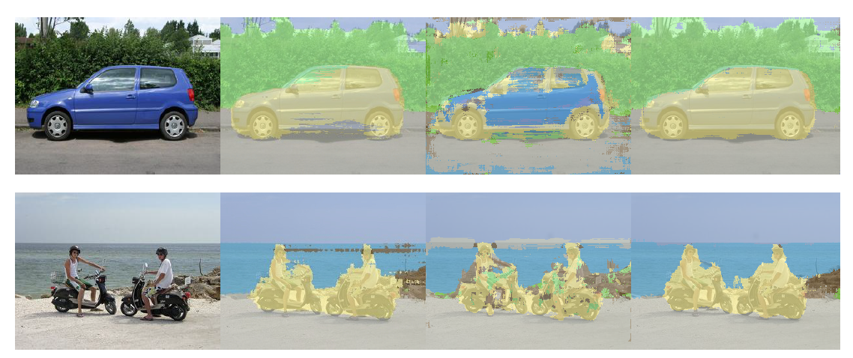
Recurrent Convolutional Neural Network

Slide 26
Fully Convolutional Network

Slide 27
Fully Convolutional Network

Slide 28
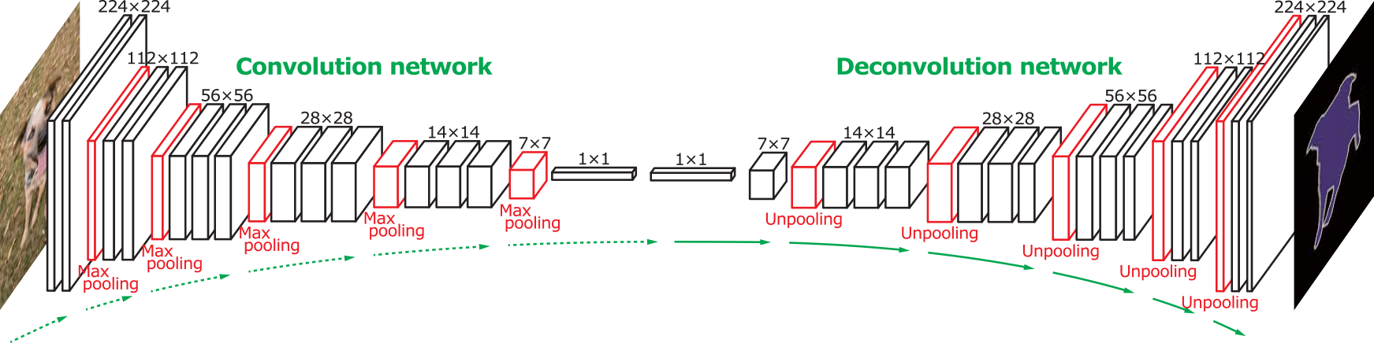
Fully Convolutional Network
?

Slide 29
Fully Convolutional Network

Slide 30
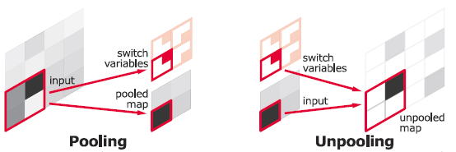
Unpooling
Remember positions when Pooling;
Reuse the position information during Unpooling.

Slide 31
Deconvolution
3 x 3 convolution
Stride: 1
Padding: 1
Input: 4 x 4
Output: 4 x 4

Slide 32
Deconvolution
Dot product
3 x 3 convolution
Stride: 1
Padding: 1
Input: 4 x 4
Output: 4 x 4

Slide 33
Deconvolution
Dot product
3 x 3 convolution
Stride: 1
Padding: 1
Input: 4 x 4
Output: 4 x 4

Slide 34
Deconvolution
3 x 3 convolution
Stride: 2
Padding: 1
Dot product
Input: 4 x 4
Output: 2 x 2

Slide 35
Deconvolution
3 x 3 deconvolution
Stride: 2
Padding: 1
Input gives weight for the filter
Input: 2 x 2
Output: 4 x 4

Slide 36
Deconvolution
3 x 3 deconvolution
Stride: 2
Padding: 1
Input gives weight for the filter
Input: 2 x 2
Output: 4 x 4

Slide 37

Deconvolution
Add padding around each pixel;
Apply a convolution.

Slide 38
Loss functions
Cross Entropy: $CE\left(p, \hat{p}\right)=−(p∙\log\left(\hat{p}\right)+\left(1−p\right)∙\log\left(1−\hat{p}\right))$
Weighted Cross Entropy: $WCE\left(p, \hat{p}\right)=−(β∙p∙\log\left(\hat{p}\right)+\left(1−p\right)∙\log\left(1−\hat{p}\right))$
Balanced Cross Entropy: $BCE\left(p, \hat{p}\right)=−(β∙p∙\log\left(\hat{p}\right)+(1−β)∙\left(1−p\right)∙\log\left(1−\hat{p}\right))$
Dice Loss: $DL\left(p, \hat{p}\right)=1−\frac{2∙p∙\hat{p} + 1}{p + \hat{p} + 1}$

Slide 39

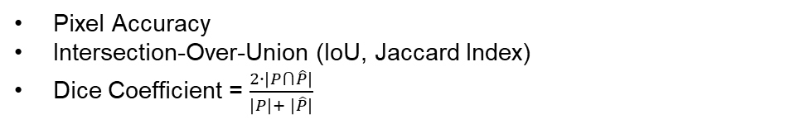
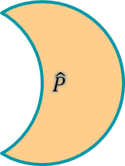
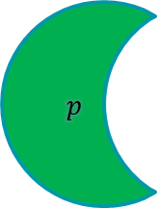
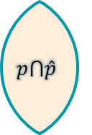
Metrics
Pixel Accuracy
Intersection-Over-Union (IoU, Jaccard Index)
Dice Coefficient = $\frac{2∙\left|P⋂\hat{P}\right|}{\left|P\right|+ \left|\hat{P}\right|}$
$$p$$
$$\hat{P}$$
$$p⋂\hat{p}$$

Slide 40
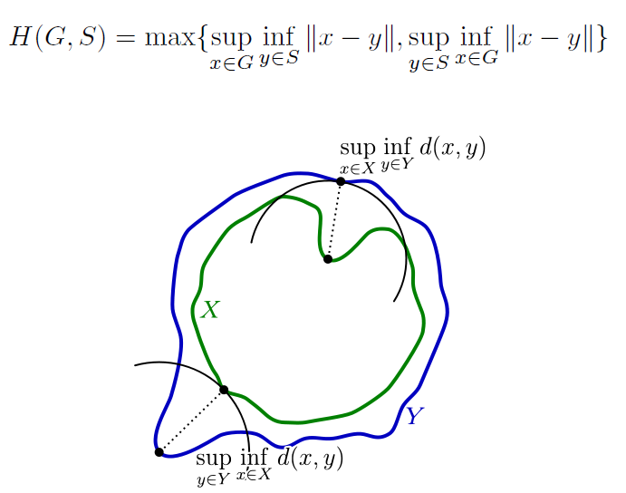
Metrics
Hausdorff distance

Slide 41
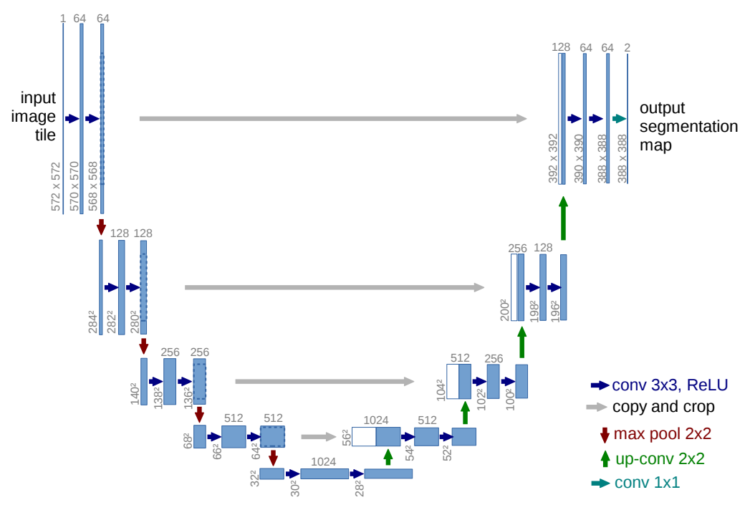
U-Net

Slide 42
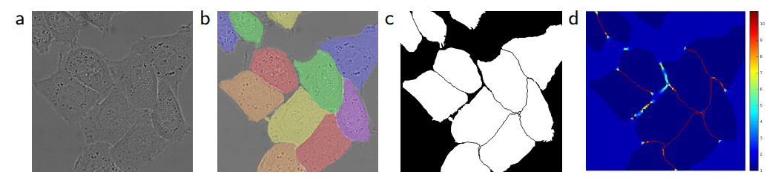
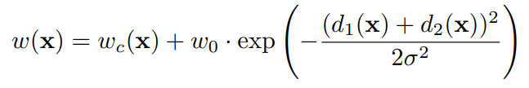
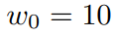
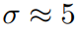
Weight map

Slide 43
Tips & Tricks
Train on different image scales;
Train on cropped images and predict on full images;
Classifier can be used to determine whether to do segmentation or not;
Use the knowledge of task peculiarities;
Test Time Augmentations can increase the accuracy.

Slide 44
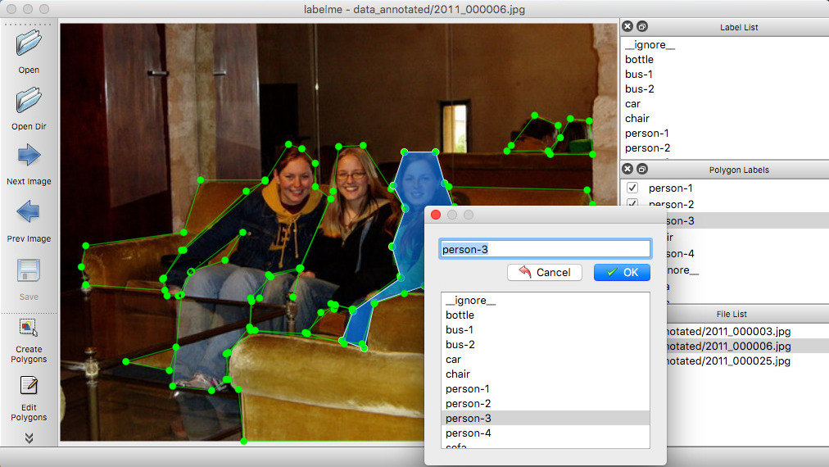
Data acquisition & labeling
LabelMe

Slide 45
Useful resources
http://www.arxiv-sanity.com/search?q=semantic+segmentation
https://github.com/mrgloom/awesome-semantic-segmentation
https://github.com/tangzhenyu/SemanticSegmentation_DL
https://arxiv.org/pdf/1505.04597.pdf – U-Net paper
https://people.eecs.berkeley.edu/~jonlong/long_shelhamer_fcn.pdf – FCN paper

Slide 46
Thank you for attention!

Slide 47
Q&A

